Slide 1
Living Beyond
AN ACTIVITY BROUGHT TO YOU BY
Notes:
Welcome to “Living Beyond” an activity brought to you by Beyond Type 1.
Introduce your name – you can add more later on the “I am a Beyond Type 1 ambassador page”

Slide 2
Notes:
We’re all here because of Type 1 diabetes, but today we are going to talk about how we live beyond our diabetes.

Slide 3
FIRST YOU’LL HEAR ABOUT ME + BEYOND TYPE 1
NEXT, I’LL INTRODUCE THE ACTIVITY WE ARE DOING
FINALLY, WE’LL BREAK UP INTO GROUPS AND FILL OUT
THE WORKSHEETS + LIVING BEYOND CARDS!
Notes:
So here’s our game plan for today.
First you’ll hear about me and a little about Beyond Type 1.
Next I’ll introduce our activity, and then we will break up into groups and do the project!

Slide 4
I am a Beyond Type 1 ambassador (can use image from old PPT that says “I am a Beyond Type 1 Ambassador”)
Notes:
(Can omit this slide if you would rather introduce yourself at the very beginning)
Introduce yourself-
I am a BT1 Global Ambassador Council Member! I’ve had Type 1 for x years, diagnosed at age x, etc. etc.

Slide 5
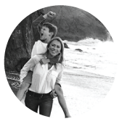
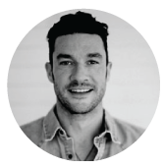
(four photos of founders – use individual ones of each – not with Mary + Nic )
Juliet, Nick, Sam and Sarah created Beyond Type 1 with a mission to educate, advocate and eventually cure Type 1 diabetes.
JULIET DE BAUBIGNY
NICK JONAS
SARAH LUCAS
SAM TALBOT
BEYOND TYPE 1 is a NEW BRAND OF PHILANTHROPY leveraging the POWER OF SOCIAL MEDIA and TECHNOLOGY, changing what it means to live with TYPE 1 DIABETES. By EDUCATING the global community about this chronic, autoimmune disease, as well as providing resources and support for those living with Type 1, BEYOND TYPE 1 IS BRIDGING THE GAP FROM DIAGNOSIS TO CURE, empowering people to both live well today and funding a better tomorrow. 100% OF EVERY DOLLAR RAISED directly supports the most promising global efforts and programs working to EDUCATE, ADVOCATE AND CURE TYPE 1 DIABETES.
Notes:
What is Beyond Type 1?
Juliet, Nick, Sam and Sarah created Beyond Type 1 with a mission to educate, advocate, and eventually cure Type 1 diabetes.
Nick and Sam were both diagnosed with T1D at age 12, and both Juliet and Sarah have kids with Type 1.
Could read mission statement if desired, otherwise it is ok to leave it out and just let audience read while you are talking.

Slide 6
Notes:
What does Beyond Type 1 do?

Slide 7
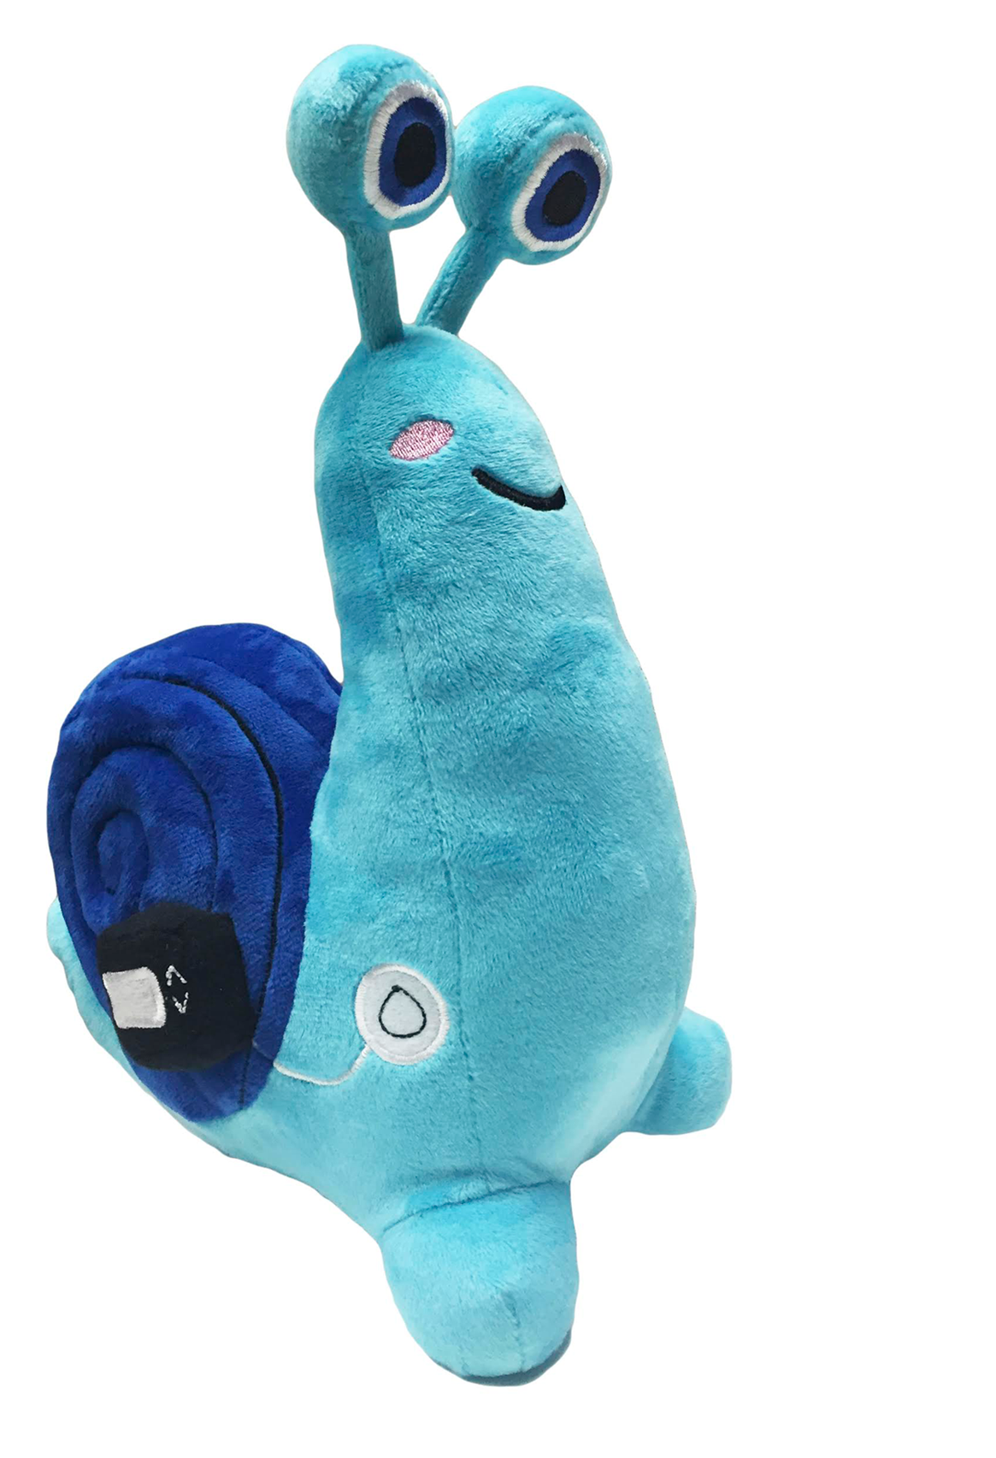
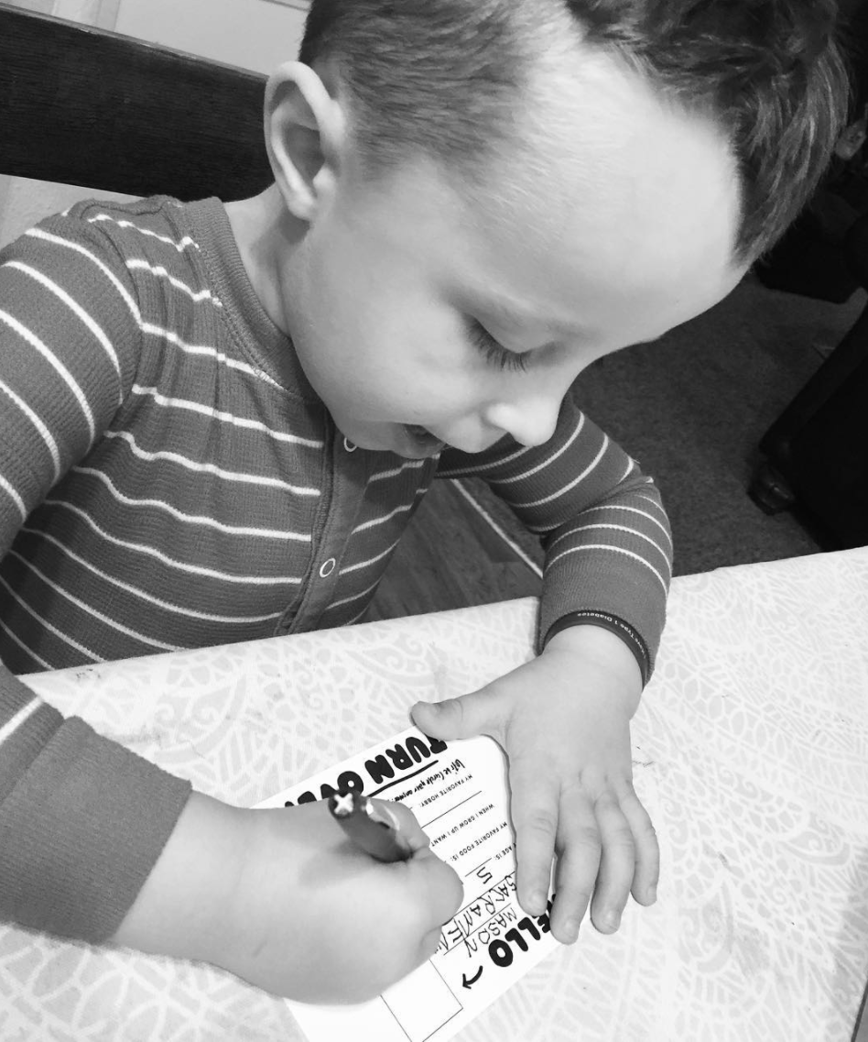
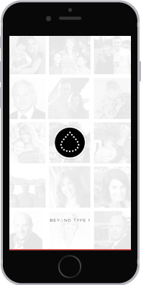
Notes:
The connect us!
Through the Beyond Type 1 Snail Mail Club, people can sign up for a T1D pen pal. Percy is the Snail Mail Mascot ☺
There is also a Beyond Type 1 app, which connects those living with Type 1 all over the world.

Slide 8
TWITTER
FACEBOOK
INSTAGRAM
YOUTUBE
THE APP
LINKEDIN
PINTEREST
SNAPCHAT
Notes:
Beyond Type 1 also connects us through social media – we are the largest diabetes organization across social media.

Slide 9
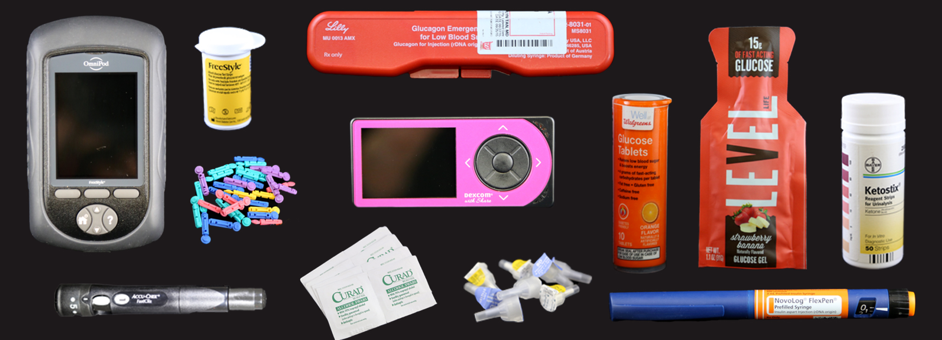
Inform!
Notes:
They inform us!
There is great information on the website – they have stories, interviews, guides, help on tough topics, and more!

Slide 10
Support!
They provide support to other programs like camps, which make life fun for us, and scientists working on a cure for us!
Notes:
They provide support to other programs like camps such as ROI, scientists doing cure research like Viacyte or advancing technology efforts, like Tidepool, and helping advocate across the globe for all Type 1 diabetics by providing grants to organizations such as Marjories Fund.

Slide 11
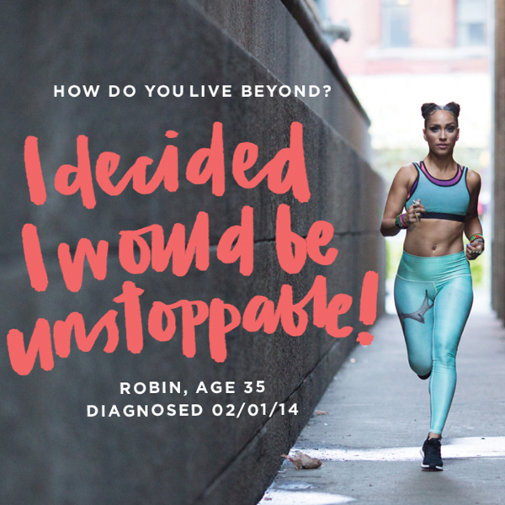
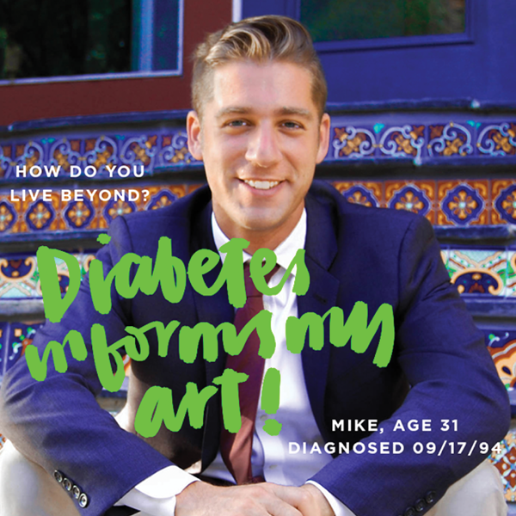
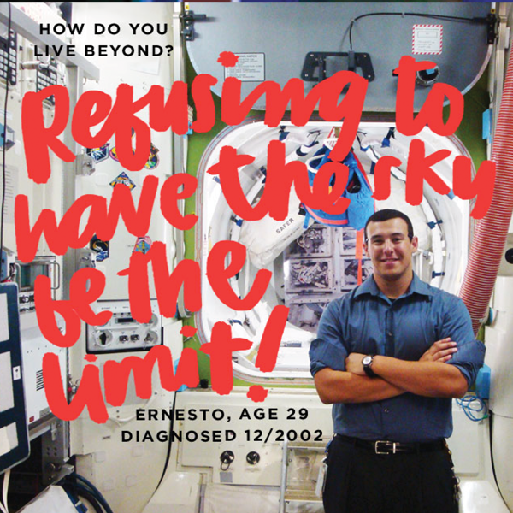
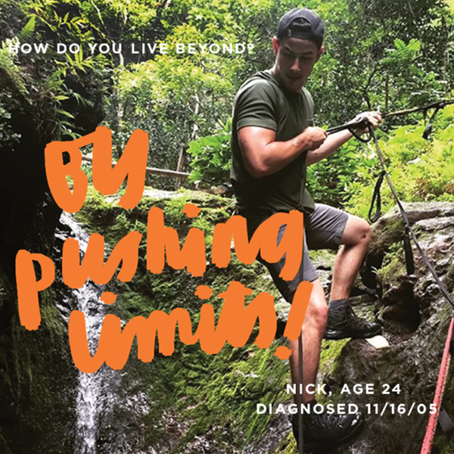
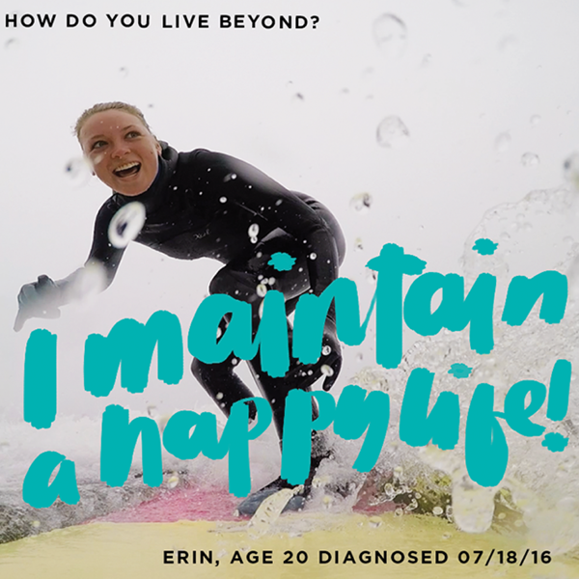
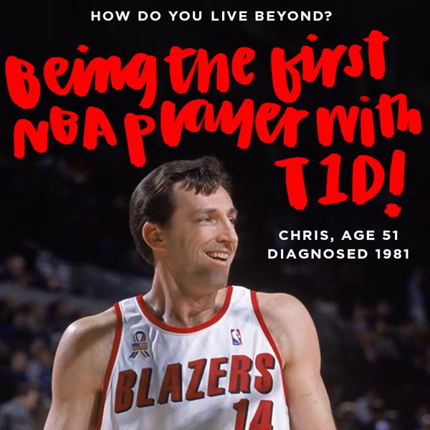
Notes:
They inspire people! From the Living Beyond Instagram campaign to Bike Beyond, Beyond Type 1 is constantly inspiring those living with Type 1.
As you can see, this is the Living Beyond Instagram.
What does it mean to live beyond? How do you live beyond? This is part of what we’ll be doing in this activity – writing our own living beyond statements!

Slide 12
Notes:
Today we are going to brainstorm these three questions and answer on your worksheet, then we’ll write out a statement of how we live beyond and will create our own living beyond wall!

