Slide 2
Notes:
Hi guys!
My name is ____ and I’m a Beyond Type 1 ambassador!
Has anyone heard of Beyond Type 1? Raise your hand if you have!

Slide 3
DO YOU KNOW WHAT BEYOND TYPE 1 IS?
Founded in February 2015, Beyond Type 1 is our foundation focused on Type 1 diabetes. We are here to educate, advocate and eventually cure this disease.
Notes:
Beyond Type 1 was started by these 4 people who all have a connection in some way to T1D.
Did you know Nick Jonas was diagnosed at age 12? So was Top Chef Sam Talbot!
Juliet and Sarah both has kids with T1D.

Slide 4
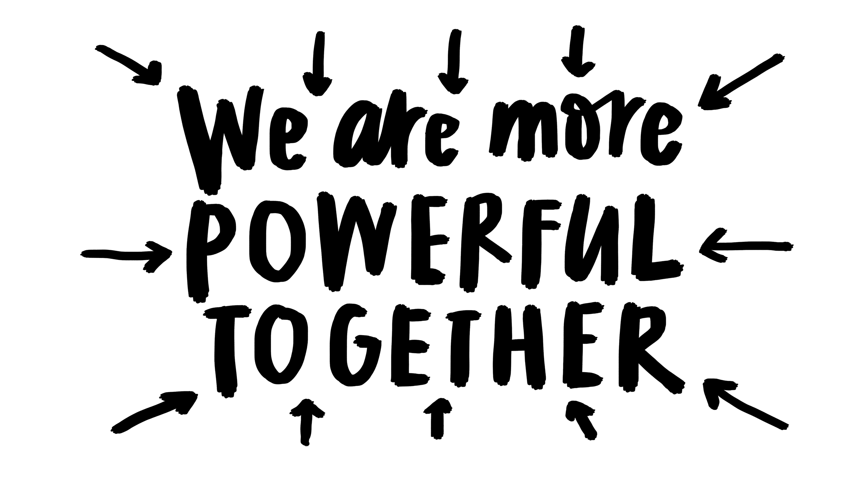
Notes:
They had an idea that by bringing people together we could be inspired and inspire each other. That we are stronger together. So they set out to build a global community.

Slide 5
Building a
Global Community
SOCIAL
Instagram
Twitter + Facebook
Website
Film: Type 1 Day 1
Digital Fundraising Campaigns
iPhone and Android App
PROGRAMS
Education Programs for Schools + Communities
Snail Mail Club (Pen Pal program)
Events
Grants to support technology
Grants to support education + outreach
Grants to support research for a cure
Notes:
Building a global community – what does that mean?
They started with the Living Beyond instagram campaign, then launched on Twitter, Facebook and a even second Instagram – and today have over 100,000 followers in over 119 countries.
They realized that people also wanted information, tips + tricks and so they started a website. Today on the website you’ll find everything from articles on how to manage your blood sugars while surfing or how to take your date and your diabetes alert dog to prom or what to do if you have ketones. You’ll also find ideas for how to a DIY fundraiser, can watch videos or read stories written by real people living with Type 1 or just be inspired.
To help connect people even more they just launched the Snail Mail Club – a pen pal program for kids like us with type 1 all over the world, and a Beyond Type 1 iPhone and Android app!
They also give money in the form of grants to support technology, education and outreach.
One of the coolest things they do is that Beyond Type 1 creates special projects like we are going to do today!
Examples-
Events have included a kid’s fashion show, a charity basketball tournament, lemonade stands.
Digital Fundraising Campaigns - $1 Million Campaign in November, Lemonade Stand Campaign this June

Slide 6
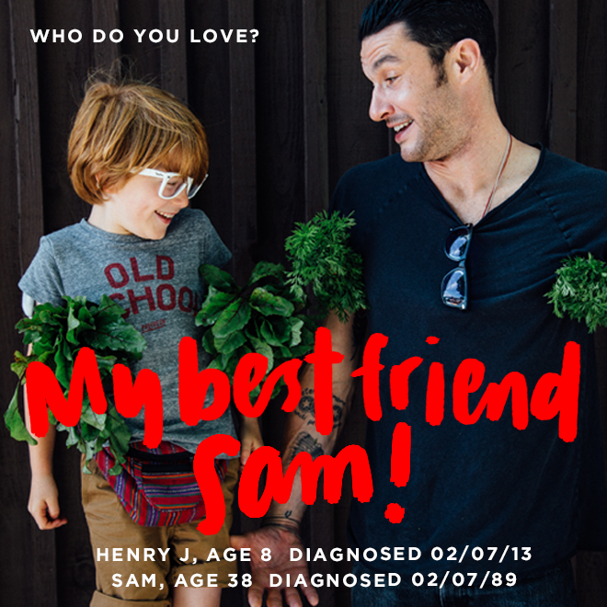
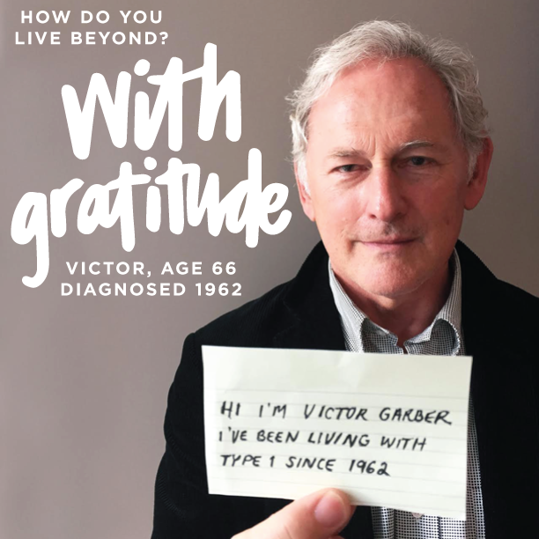
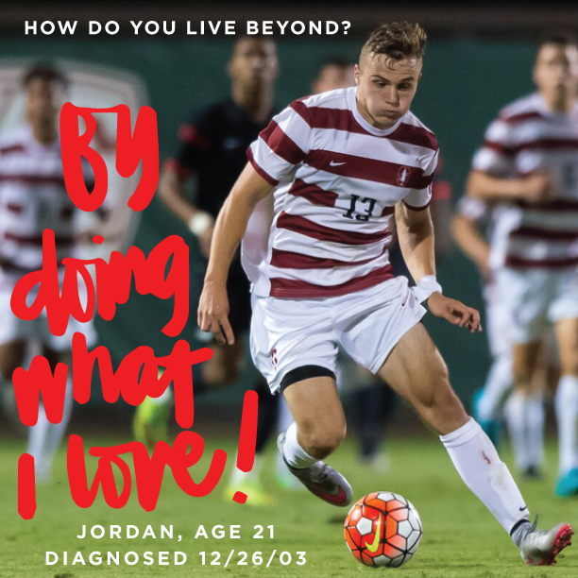
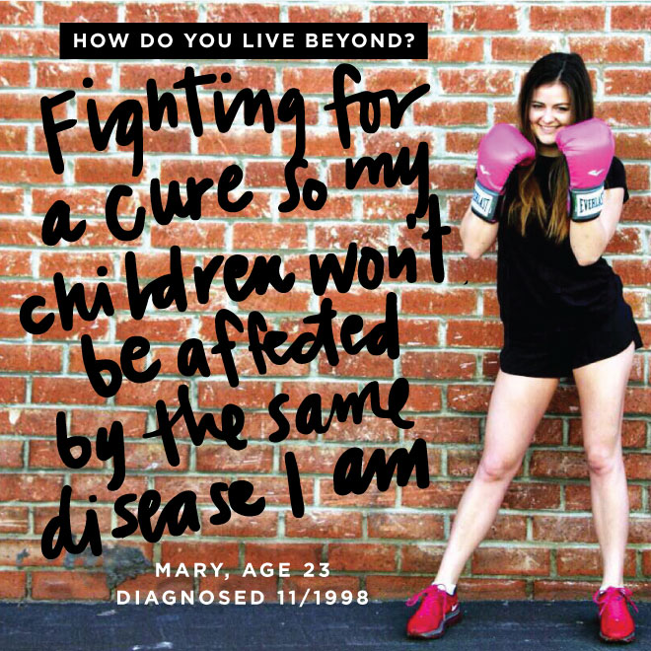
ELLADIA
RYAN
NICK
MADDEE
KELSEY
MARGARET
HENRY + SAM
VICTOR
WALKER
SIERRA
JORDAN
MARY
Notes:
Instagram was first. They asked people to share how they LIVE BEYOND their diagnosis. ( Point out a few people you think are cool! You don’t need to talk about all of them)
Elladia is only 8 and she is a model and actress!
Ryan Reed is a professional Race Car driver!
Nick Jonas is an actor and musician (and one of the co-founders!)
Maddee is 7 but is already a roller derby queen!
Kelsey is 23 and is a camp counselor at Gales Creek and Chris Dudley Basketball Camp!
Walker is an athlete and loves playing basketball with his dad Ray!
Margaret is a compatative gymnast!
Henry J and Top Chef Sam Talbot were diagnosed on the same day but 24 years apart – they both love food and cooking!
Victor Garber is an actor who is playing Firestorm on Legends of Tomorrow – he’s had type 1 diabetes for over fifty years!
Sierra Sandison is Miss Idaho 2014, and she wore her insulin pump on stage during the competition! She also started the hashtag #showmeyourpump and wrote a book about findiingthe ’sugar linings’ of diabetes!
Jordan is a professional soccer player!
Mary is the Community Partners and Programs Manager at Beyond Type 1, and never stops fighting!
The cool thing about this wall is you have to be Type 1 to be featured and anyone can submit their photo and statement on the Beyond Type 1 website

Slide 7
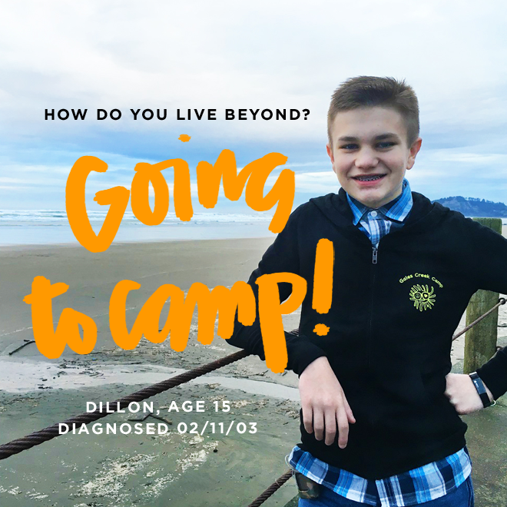
Notes:
And here I am! This is how I live beyond. I sent in my photo and statement and this is what I had to say:
Dillon’s statement: “Since I was three I have been going to Gales Creek Camp which is a summer camp for kid’s grades 1-12 T1 diabetes. This year will be my 15th session and I will be working with Beyond Type 1 to help run a “how do you live beyond” campaign. The camp and kids that I have come to know all have helped me live beyond and show that there is more to life than the disease. This year I am very excited to be giving back to them all with the opportunity to help them share with the world what it means to be a type 1 diabetic. Throughout the years and ups and down I have always relied on the camp to give me a place to feel welcome and a place where nobody is different. Going to school and having to explain almost every day what I am doing, why I have to poke my fingers, what’s that on my hip, or did you eat too much junk food as a baby; I can come to the camp and know that everyone else has gone through it all and will not judge or ask questions like that. This allows me and many others to have a sort of safe haven away from all the troubles of the real world and just relax and have a good time and be as normal as possible. I am a very big history buff and love to travel. I enjoy shooting in both the real and virtual world. I play alto saxophone for my high school concert, pep, and marching band. My name is Dillon and this is how I live beyond!”

Slide 8
Notes:
And today we’re going to write our own statements and create our own wall here at camp.
We are going to think about how do we live beyond?
Think about your photo, what would you envision yourself doing?

Slide 9
Notes:
Would you be flying on the trapeze? Paddleboarding? Playing hockey?

Slide 10
Notes:
Would you just be kicking back and relaxing or would you be competing? What would you show the world?
Today we are going to ask you three questions

Slide 11
WHY IS TYPE 1 HARD SOMETIMES?
DIFFICULT THINGS ABOUT T1
Notes:
Why is Type 1 hard sometimes?
What are some of the difficulties?

Slide 12
WHAT ARE THE GOOD THINGS ABOUT TYPE 1
GOOD THINGS ABOUT T1
Notes:
What are the good things about Type 1?
For example, we get to go to cool camps just for us!

Slide 13
WHAT IS A POWER UP?
HOW CAN WE GET THROUGH THE DIFFICULT TIMES WITH OUR OWN POWER UPS?
Notes:
What is a “Power Up?”
How can we get through the difficult times? What helps you through?
EXAMPLE: For me, I like to talk to my friends with T1D – if I’m having a hard time I know they get what I’m going through, and talking to them always makes me feel better.

Slide 14
EDUCATE, ADVOCATE, CURE
Notes:
So now we are going to break into groups and fill out the worksheet and then talk about some of these things!

Slide 15
HOW DO YOU LIVE BEYOND?
Notes:
And then we’re going to write our own statements about how we live beyond, and we are going to make our own wall here at camp!

Slide 16
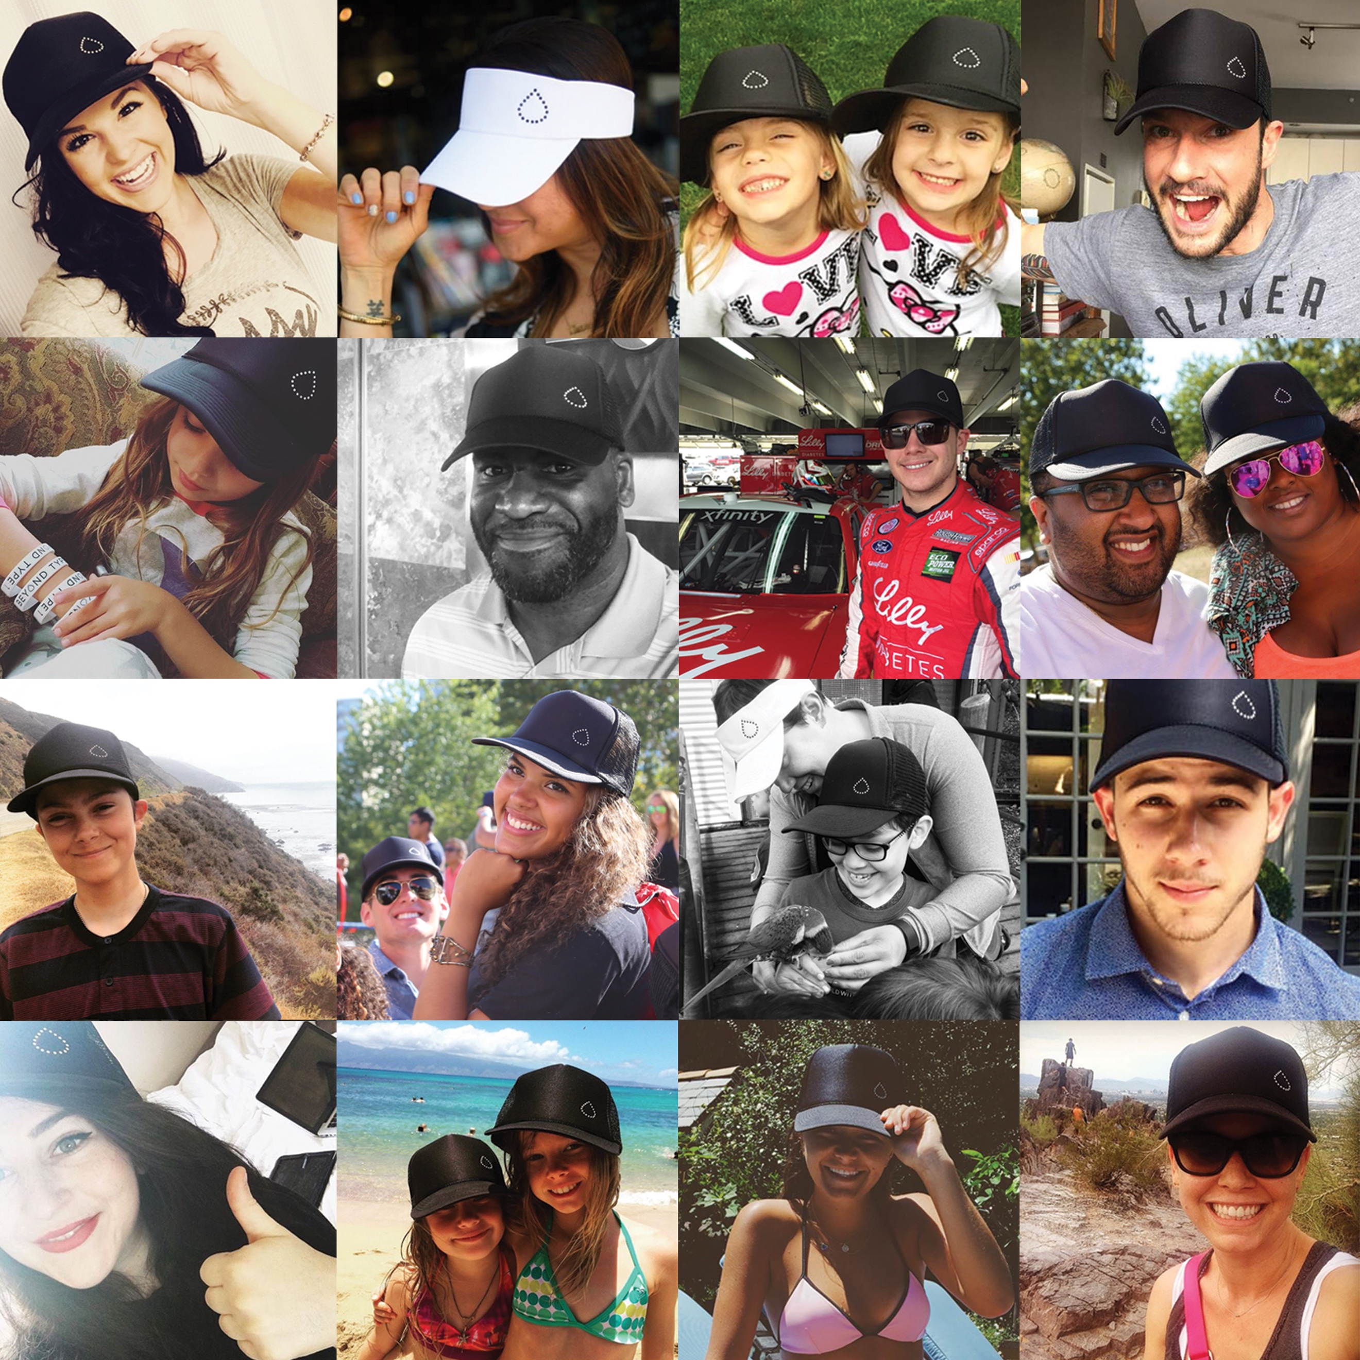
GAME PLAN
Break into groups
Fill out worksheet
Discussion
“How Do You Live Beyond” statement
Make our wall!
Notes:
Game plan!
Now we are going to break into groups, fill out the worksheets, and have a little discussion!
After that we can think of our own statements and write them on the cards, then we are going to put the cards all up on a wall

