Slide 1
A LOT OF PEOPLE HAVE HEARD OF DIABETES,
AND A LOT OF PEOPLE HAVE AN IDEA OF WHAT
THEY THINK IT IS.
Notes:
Hey Guys! I’m (NAME HERE) and today I’m going to be talking about Type 1 Diabetes.
A lot of people have heard about diabetes, and a lot of people have an idea of what they think it .is

Slide 2
Notes:
Nearly 422 million people around the world have a form of diabetes.

Slide 3
1 IN 10 PEOPLE WITH DIABETES HAVE TYPE 1 DIABETES
TYPE 1
TYPE 2
Notes:
There are two main types of diabetes, Type 1 and Type 2.
About 1 in 10 people with diabetes has Type 1, like me! (Or, like my child, sibling, etc. depending on presenter)

Slide 4
AUTO-IMMUNE DISEASE
PANCREAS STOPS PRODUCING INSULIN,
A HORMONE NEEDED TO CONTROL GLUCOSE IN THE BLOOD STREAM
NOT CURRENTLY A CURE
NOT PREVENTABLE
NOT A LIFESTYLE DISEASE
FULL TIME BALANCING ACT
Notes:
What is Type 1 diabetes, also known as T1D?
An autoimmune disease
This is when the body attacks the healthy cells in one part of your body, in this case, the body attacked the healthy insulin-producing cells in the pancreas
Because the body destroys the healthy cells, the pancreas stops producing insulin, a hormone that is needed to control glucose in the bloodstream.
People with T1D must inject themselves with insulin and monitor their blood sugar (also known as blood glucose or BG)
There is currently no cure for Type 1 diabetes.
Researchers and scientists are working on it though!
It is not preventable.
It is not a lifestyle disease.
T1D is a full time balancing act, as T1Ds must monitor their blood sugar and give insulin accordingly. It may sound simple, but it sure isn’t!

Slide 5
WHAT IS
WHAT IS
BODY DOESN’T
MAKE INSULIN
BODY CAN’T USE
INSULIN PROPERLY
MUST INJECT
INSULIN TO LIVE
MANAGED THROUGH DIET, EXERCISE, ORAL MEDICATION AND SOMETIMES INSULIN
AUTOIMMUNE DISORDER. NOT RELATED TO DIET
OR EXCERCISE
INFLUENCED BY DIET, EXERCISE AND GENETICS
DIAGNOSED AT
ANY AGE, BUT
50% ARE KIDS
DIAGNOSED AT
ANY AGE
Notes:
What is Type 1 and what is Type 2?
In Type 1 diabetes, the body doesn’t make insulin.
In Type 2, the pancreas often still produces insulin, but the body can’t properly use it.
Type 1 diabetics must inject themselves with insulin in order to live.
Type 2 diabetes is managed through diet (food), exercise, oral medication, and sometimes insulin.
Type 1 diabetes is an autoimmune disorder, and is not related to diet (food) or exercise.
Type 2 diabetes is influenced by diet (food), exercise, and genetics.
T1D can be diagnosed at any age, but 50% - half the diagnosis! - are in kids.
Type 2 diabetes can also be diagnosed at any age.

Slide 6
YOU MIGHT NOT NOTICE DIABETES SOMETIMES.
IN FACT, SOME OF YOU PROBABLY DIDN’T KNOW
I HAD TYPE 1 DIABETES BEFORE THIS.
Notes:
You might not notice diabetes sometimes.
In fact, some of you probably didn’t even know I had Type 1 diabetes before this!

Slide 7
WE LOOK FINE ON THE OUTSIDE,
but on the inside our bodies work
just a bit differently.
Notes:
Type 1 can be an invisible disease.
We look fine on the outside, but on the inside our bodies work just a little bit differently.
Because our bodies work a little different, we have a lot of stuff to do!

Slide 8
WELL, WHEN I GET UP IN THE MORNING,
HERE IS WHAT I HAVE TO DO:
Notes:
What extra stuff do I have to do? Well, when I get up in the morning here is what I have to do…

Slide 9
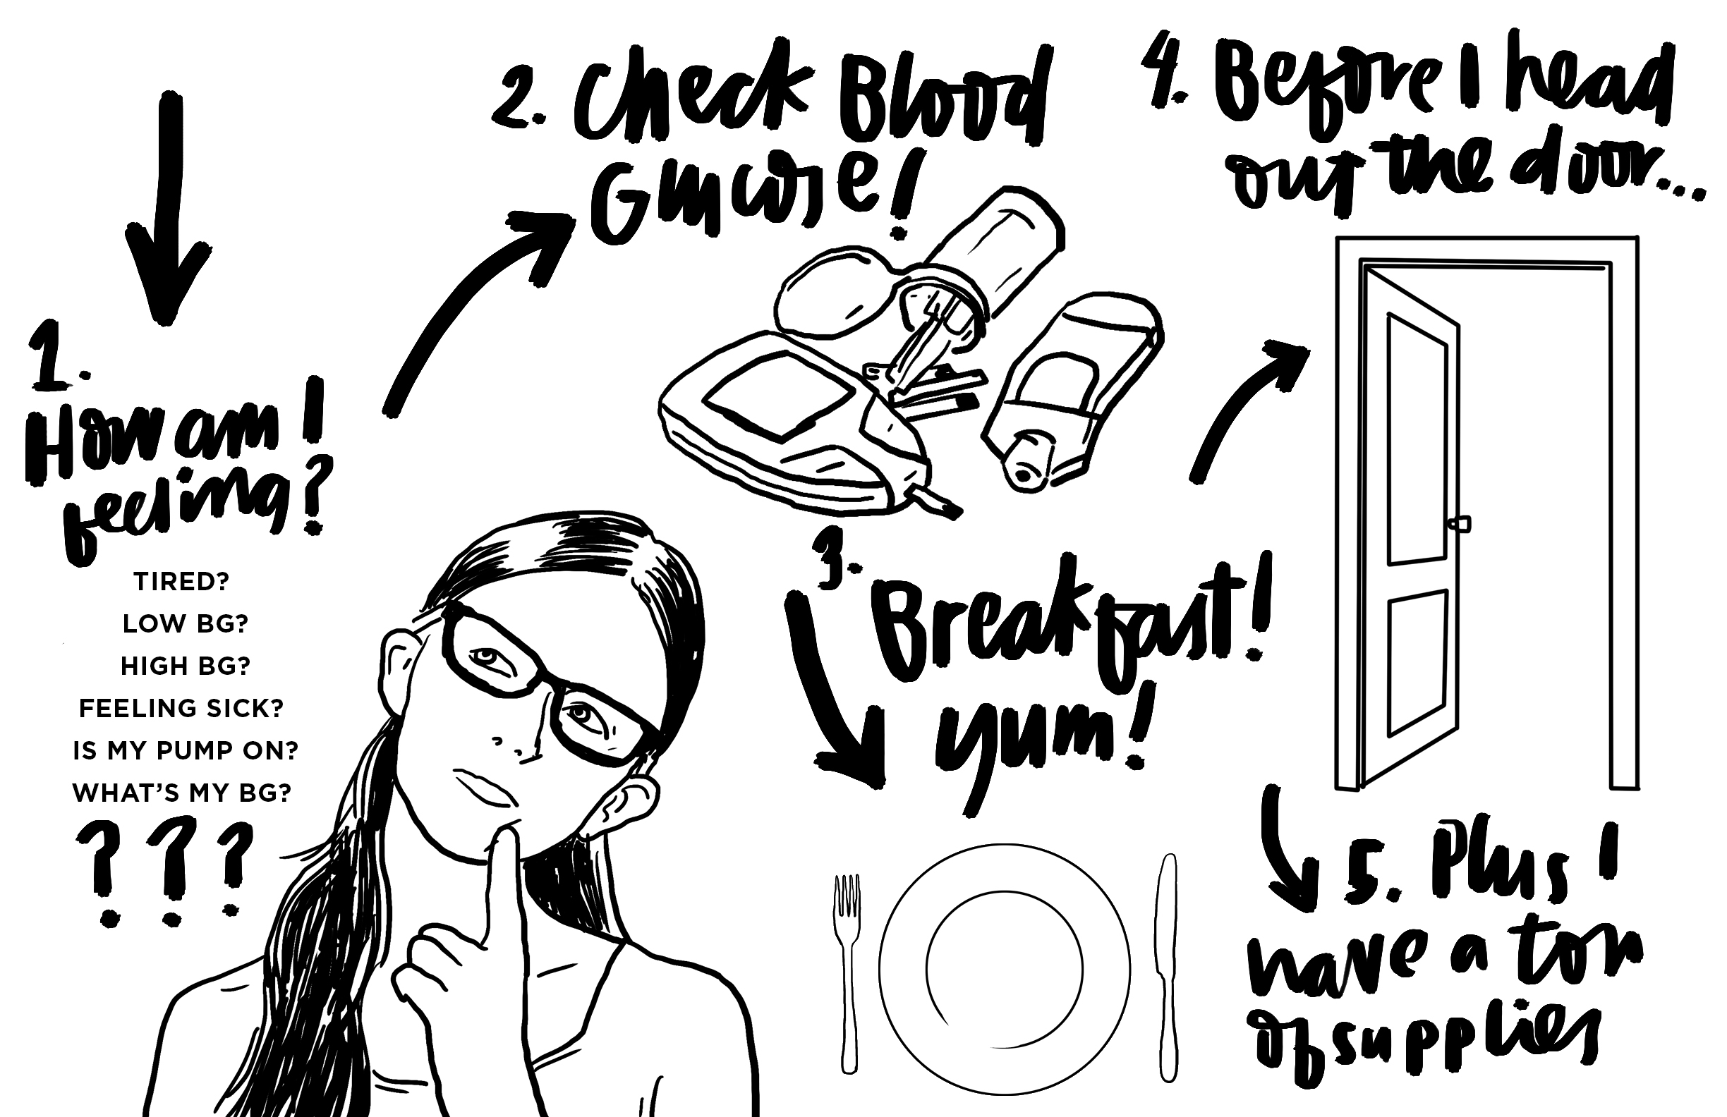
Notes:
First, I have to check and see how I’m feeling!
Am I tired because my blood sugar was low all night, so I had to stay awake and eat sugar?
Do I feel sick because my blood sugar has been high all night?
What is my BG right now, is it high or low?
Is my insulin pump still connected?
Second, I have to test my blood sugar and correct accordingly.
I might also have to check for ketones if I have been running high.
Third, before breakfast, I have to calculate all my carbs and figure out how much insulin to give myself (or have my parents help give to me)
Hey, it’s great practice for my math class, right? Haha!
Before I head out the door for school, I have to check my blood sugar again. If it’s low, I need a snack and can’t get on the bus or drive until it goes up.
Plus I have a ton of supplies! So I need to check and make sure I have them all with me.

Slide 10
THE SUPPLIES I HAVE TO BRING TO SCHOOL CAN INCLUDE:
MY INSULIN PUMP, PENS, OR SYRINGES
MY CGM RECEIVER OR A PHONE THAT IS CONNECTED
MY BLOOD GLUCOSE METER
A PRICKER TO TEST MY BG
TEST STRIPS FOR MY METER
ALCOHOL SWABS TO CLEAN MY FINGERS BEFORE TESTING
EXTRA NEEDLES FOR THE PRICKER
EXTRA BATTERIES AND/OR A CHARGER FOR MY METER/ PUMP/ CGM
EXTRA PUMP SITES IN CASE ONE RIPS OUT ACCIDENTLY OR STOPS WORKING
GLUCOSE TABLETS, CANDY OR JUICE IN CASE MY BG IS LOW
AN EMERGENCY GLUCAGON IN CASE I PASS OUT FROM A LOW BG
A MEDICAL ID TAG OF SOME KIND
Notes:
Here’s a list of all the supplies I might have to bring to school!
(You don’t need to read the whole list, let the audience read the list)
My insulin pump, pens or syringes (plus a bottle of insulin if I use syringes)
My CGM receiver or a phone that is connected to it
My blood glucose (also known as BG) meter
A finger pricker to test my BG
Test strips for my meter
Alcohol swabs to clean my fingers before poking and testing
Extra needles for the pricker
Extra batteries and/ or a charger for my meter, pump, or CGM
Extra pump sites in case one rips out accidently or stops working
Glucose tablets, candy or juice in case my BG is low
An emergency glucagon in case I pass out from a low BG
A medical ID tag of some kind

Slide 11
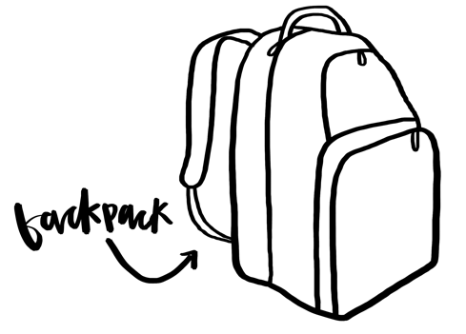
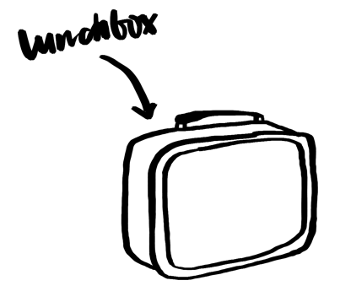
PLUS ALL THE REGULAR STUFF.
Notes:
Oh plus, I have to bring all the regular stuff too, like my backpack, homework and lunch.

Slide 12
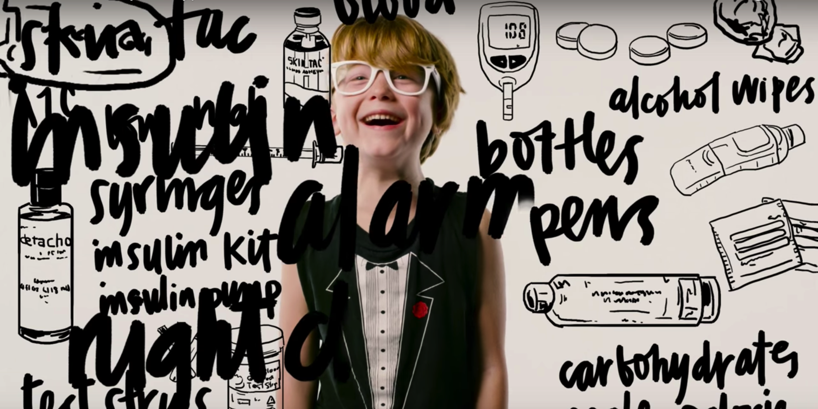
Notes:
It’s so much stuff! It could make a person go crazy trying to remember it all!

Slide 13
DURING THE SCHOOL DAY I HAVE TO DO SOME EXTRA STUFF TOO, LIKE…
TESTING MY BG BEFORE WE TAKE A TEST. IF IT’S TOO HIGH OR LOW,MY BRAIN DOESN’T WORK AS WELL AND
I CAN’T TAKE THE TEST UNTIL IT RETURNS TO NORMAL RANGE.
I MIGHT NEED TO GO TO THE NURSES OFFICE FOR HELP TREATING A HIGH
OR LOW BG, OR BECAUSE I DON’T
FEEL GOOD.
I MIGHT HAVE TO SIT OUT OF P.E. BECAUSE OF A LOW BG WHILE I
HAVE SOME SUGAR.
BEFORE WE HAVE LUNCH OR A
SNACK, I HAVE TO TEST MY BG AND
CALCULATE THE AMOUNT OF CARBS
IN THE FOOD, THEN CALCULATE
HOW MUCH INSULIN TO GIVE MYSELF.
BEFORE SPORTS OR EXTRA –
CURRICULAR ACTIVITIES AFTER
SCHOOL, I NEED TO TEST MY BG.
BEFORE GOING HOME, I NEED
TO TEST MY BG.
Notes:
During the school day you might notice me doing some other extra stuff too, like:
(You don’t need to read the whole list, let the audience read the list. You can point out a few if you would like)
Testing my BG before we take a test. If it is too high or low, my brain doesn’t work as well and I can’t take the test until my BG returns to a normal range.
I might need to go to the nurse’s office for help treating a high or low BG, or because I don’t feel good.
I might have to sit out of P.E. because of a low BG while I have some sugar and wait for it to return to normal
Before we have lunch or a snack, I have to test my BG and calculate the amount of carbs in the food, then calculate how much insulin to give myself.
Before sports or extracurricular activities after school, I need to test my BG.
Before going home, I need to test my BG. If it is low, I can’t drive or get on the bus.

Slide 14
SOMETIMES I MIGHT NEED HELP
Notes:
Sometimes I might need help with my T1D
If I’m not acting like myself or your are worried, the best thing to do is get an adult like a teacher or nurse!
When I’m low, here’s how you can help me: (insert personal preference and protocol here)
When I’m high, here’s how you can help me: (insert personal preference and protocol here)
(If you want to use this as an opportunity to describe how you feel when your BG is high or low, you can! If you don’t want to tell your classmates you don’t have to!)

Slide 15
Notes:
You might not know it, but there are a lot of people out there with T1D. People like…

Slide 16
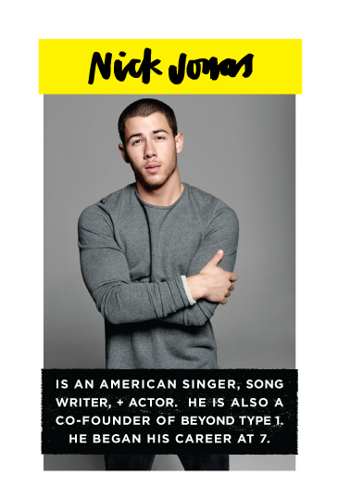
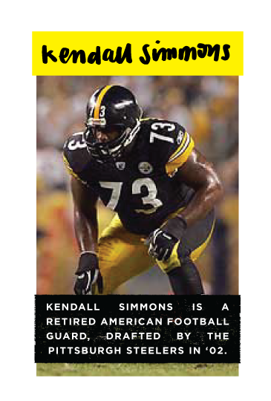
Notes:
Nick Jonas!
Nick is a singer, songwriter and actor. He is also a co-founder of Beyond Type 1!
Sierra Sandison!
Sierra is Miss Idaho 2014. She wore her insulin pump while competing onstage and started a viral social media campaign called #ShowMeYourPump
Kendall Simmons!
Kendall is a retired American Football player. He was drafted by the Pittsburgh Steelers in 2002 and also played for the New England Patriots and Buffalo Bills.

Slide 17
Notes:
Brec Bassinger!
Brec is best known for Bella and the Bulldogs and now stars on the show School of Rock.
Sam Fuld!
Sam is an American Professional Baseball Outfielder for the Oakland A’s. He was diagnosed at 10 years old.
Victor Garber!
Victor is a Canadian film, stage and television actor and singer. He has been living with Type 1 diabetes since 1962!

Slide 18
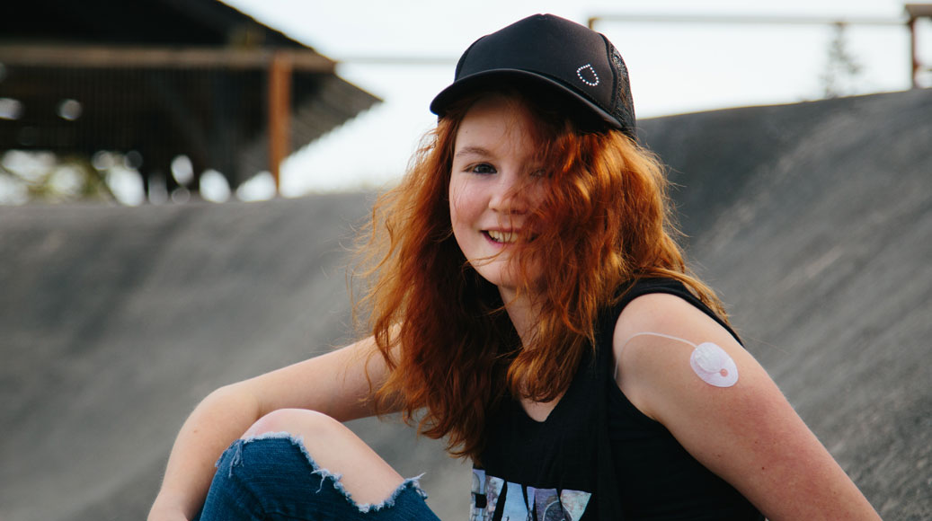
EVERYONE HAS
SOMETHING
Notes:
The important thing to remember is that everyone has something.
Maybe you have a peanut allergy, maybe you wear glasses or a hearing aid.
Each person has their own battles, and mine is Type 1 Diabetes.

Slide 19
I WANT THIS TO GO AWAY
BUT IN THE MEANTIME, I HAVE A FULL-TIME JOB BEING MY BODIES PANCREAS, AND THAT FULL-TIME JOB HAS
A LOT OF HELPERS. MY PARENTS, TEACHERS, FRIENDS, OTHER STUDENTS, AND POSSIBLY A DOG!
Notes:
I want this to go away.
But in the meantime, I have a full-time job being my bodies pancreas, and that full time job has a lot of helpers.
My parents, teachers, friends and other students. Maybe even a Diabetic Alert Dog!

Slide 20
MY OTHER JOB RIGHT NOW IS LEARNING TO LIVE BEYOND THIS DIAGNOSIS.
You can all help me!
Ask questions, don’t be afraid, know
it isn’t contagious and you can’t
catch it from me.
Notes:
My other job right now is learning how to live beyond this diagnosis. My type 1 diabetes is only a small part of who I am, and I will not be defined or held back by my disease.
And you can all help me!
Ask questions
Don’t be afraid – know that T1D is not contagious and you can’t catch it from me.
And please, don’t make fun of me for having a disease! Like I said, we all have something!

Slide 21
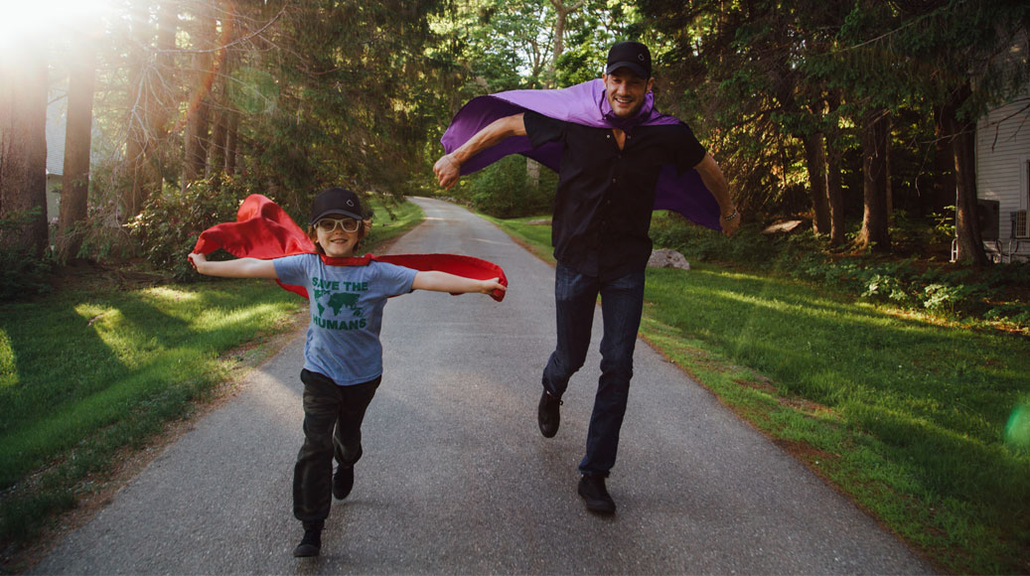
Notes:
Thank you all for listening.
Does anyone have any questions?
Here are some examples of questions you might be asked:
Is T1D contagious?
No
Do those machines make them a robot?
No
Why do you have diabetes?
Doctors and Scientists aren’t exactly sure why people get T1D, but they are studying this right now!
Can you die from Diabetes?
No, but if you don’t take care of yourself and your blood sugar levels, you can have complications that make life a lot harder. You can also die from blood sugars that are too high for too long – your body goes into something called Diabetic Ketoacidosis, or DKA, which is very dangerous and in extreme cases can lead to death. As long as I do a good job taking care of myself though, I will live a long and happy life!
Do finger checks or needles hurt?
Personal answer
Do you get scared poking yourself?
Personal answer
Will you run out of blood from checking your fingers?
No
Why can’t insulin be taken by mouth?
Needs to go into the bloodstream, not into your stomach
Why do you have to eat a snack sometimes when others don’t get snacks?
When my blood glucose is low, it means my body is low on sugar, so I need to eat a snack to bring it back up to a normal level. Sometimes I don’t even want to drink a juice box of have candy, but I have to anyways!
My cat/dog/grandma has diabetes, is that the same?
No, diabetes in animals is different and requires a different kind of maintenance
Older people usually have Type 2 diabetes, but can also have Type 1.

